Slide 1
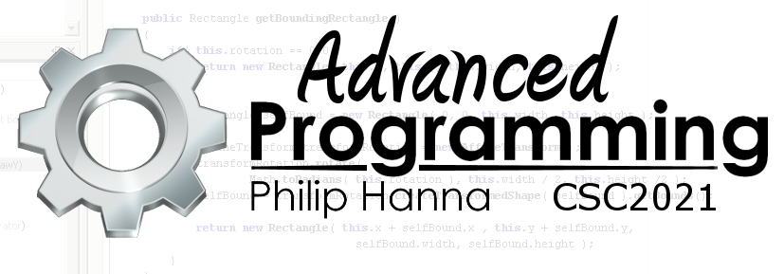
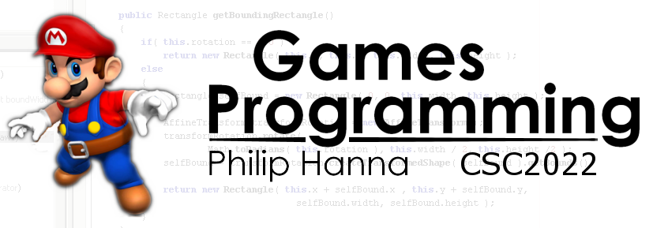
AI: Movement
Introduction to AI controlled movement

Slide 2
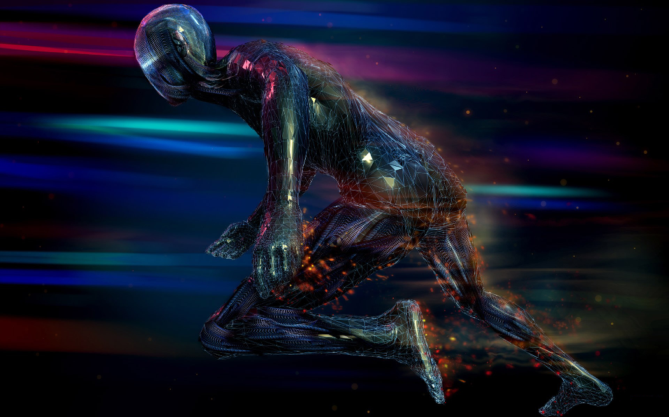
Introduction to
AI Movement

Slide 3

The aim of movement AI is to move game objects around the level. The movement algorithms take as input information about the layout of the world and output the desired form of movement.
Some algorithms only require the object’s position and a target position. Others algorithms require lots of interaction with objects (e.g. collision avoidance, etc.).
Some algorithms directly output a new velocity (termed kinematic movement), others output an acceleration/force used to update the object’s velocity (termed dynamic or steering behaviours)

Slide 4
Game objects can have a position and an orientation. In some games (e.g. tile based) a movement algorithm can directly update the position and orientation. However, this will look unrealistic in other types of game (e.g. driving).
In order to permit continuous (2D) movement it is necessary to store:
Steering algorithms output a force or acceleration to apply to the directional or rotational velocities. Using simplified Newton Euler equations, the variables can be updated as:
velocity += acceleration * timeΔ
rotation += angular_acc * timeΔ
position += velocity * timeΔ
orientation += rotation * timeΔ
Vector position
float orientation;
Vector velocity;
float rotation;

Slide 5

Kinematic Movement Algorithms

Slide 6

Kinematic movement algorithms operate using positions and orientations. The output is a target velocity (speed + orientation).
The speed may simply vary between full speed and stationary, i.e. kinematic algorithms do not use acceleration.
This section will explore the following basic forms of kinematic movement algorithm:
Seek() // Seek towards a target point
Flee() // Flee from a specified point
Arrive() // Stop at the target point

Slide 7
: Seek
Seek inputs a current and target location and calculates a direction from the current to target locations, providing an output velocity.
The velocity can be used to define the output orientation if desired.
Current velocity
Target velocity
Seek(Vector source, Vector target,
float maxSpeed ) {
Vector velocity
= (target – source).normalise()
* maxSpeed;
return velocity;
}
DetermineOrientation(
Vector velocity, float currentOrientation ) {
if( velocity.length() == 0 )
return currentOrientation;
else
return Math.atan2( -velocity.x, velocity.y)
}
normalise() gives vector of unit length and same direction
See comment on next slide for atan

Slide 8
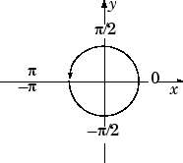
: Flee
Flee is the opposite of Seek, i.e. the object moves away from their target. It can simply be defined as the opposite of the velocity returned by Seek, i.e:
Aside: Why atan2 on last slide?
atan2 computes the arctangent of y/x in a range of (−π, π), i.e. it determines the counter clockwise angle (radians) between the x-axis and the vector <x,y> in 2D Euclidean space. The normal atan function returns a range of (−π/2, π/2)
This is useful to find the direction from one point to another.
Flee( Vector source, Vector target,
float maxSpeed ) {
Vector velocity
= (source – target).normalise()
* maxSpeed;
return velocity;
}

Slide 9
: Arrive
Arrive ( Vector source, Vector target,
float maxSpeed, float nearRadius ) {
float slowingFactor = 0.2;
Vector velocity = [0,0,...];
Vector separation = (target – source);
if( separation.length() < nearRadius )
return velocity;
velocity = separation / slowingFactor;
if( velocity.length() > maxSpeed )
velocity =
velocity.normalise() * maxSpeed;
return velocity;
}
A limitation of Seek is that it can keep overshooting the target. A means of overcoming this is to provide a buffer ‘close enough’ region. Another is to reduce the speed as the target comes close. Both approaches can be combined:
slowingFactor = slowing strength
Return initial velocity = 0.0
vel= max * 0.4
vel= max * 0.6
vel= max * 0.75
Closeness
threshold
vel= max
Determine velocity, and cap at max speed if needed
vel = max

Slide 10

Key takeaways:
AI controlled entities often need some way of moving about their environment.
Kinetic movement provides a simple (and instantaneous) way of directing the velocity

